Slide 1

PIZZA SALES ANALYSIS

Slide 2
Introduction
Analyzing pizza sales data is essential for gaining insights into customer preferences, sales trends, and overall business performance. This analysis, conducted using SQL, addresses several key questions to provide a comprehensive understanding of the pizza sales landscape. We begin by retrieving the total number of orders placed, followed by calculating the total revenue generated from these sales. Further, we identify the highest-priced pizza and the most commonly ordered pizza size. The analysis also includes listing the top 5 most ordered pizza types along with their quantities. By joining the necessary tables, we determine the total quantity of each pizza category ordered and analyze the distribution of orders by hour of the day. Additionally, we explore the category-wise distribution of pizzas, group orders by date to calculate the average number of pizzas ordered per day, and identify the top 3 most ordered pizza types based on revenue. Finally, we calculate the percentage contribution of each pizza type to total revenue, analyze the cumulative revenue generated over time, and determine the top 3 most ordered pizza types based on revenue within each pizza category. Through this detailed SQL-based analysis, we aim to uncover valuable insights that can inform strategic decisions and enhance business outcomes.
2

Slide 3
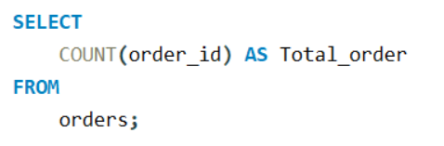

RETRIVE THE TOTAL NUMBER OF ORDERS PLACED.
2

Slide 4
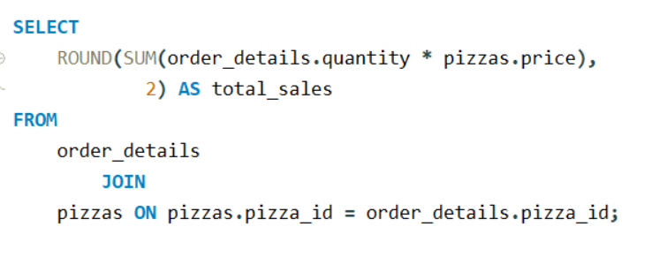

CALCULATE THE TOTAL REVENUE GENERATED FROM PIZZA SALES.

Slide 5
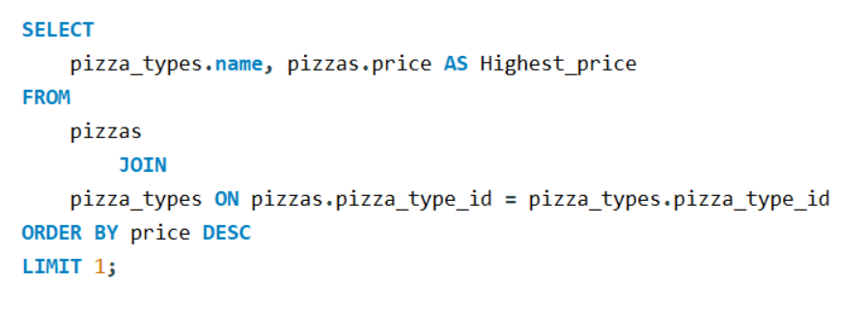
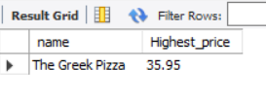
IDENTIFY THE HIGHEST-PRICED PIZZA.

Slide 6
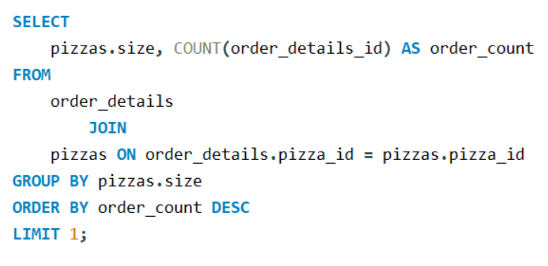
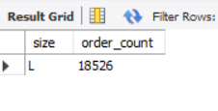
IDENTIFY THE MOST COMMON PIZZA SIZE ORDERED.

Slide 7
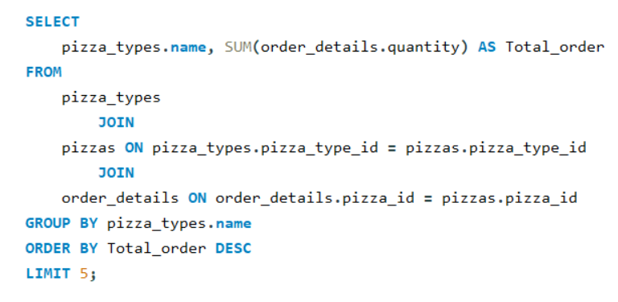
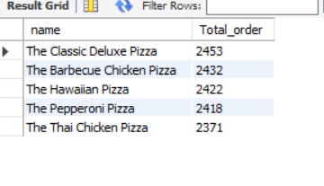
LIST THE TOP 5 MOST ORDERED PIZZA TYPES ALONG WITH THEIR QUANTITIES.

Slide 8
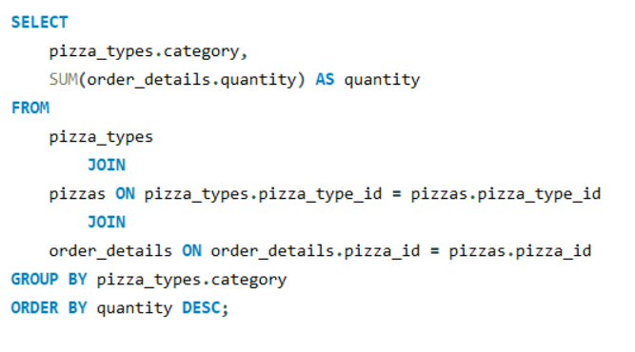
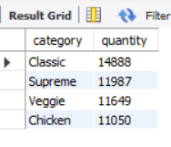
JOIN THE NECESSARY TABLES TO FIND THE TOTAL QUANTITY OF EACH PIZZA CATEGORY ORDERED.

Slide 9
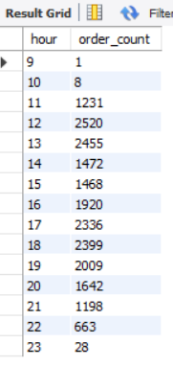
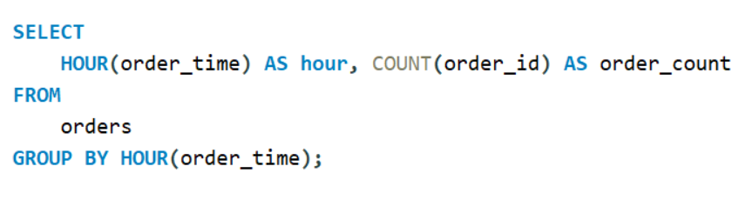
DETERMINE THE DISTRIBUTION OF ORDERS BY HOUR OF THE DAY.

Slide 10
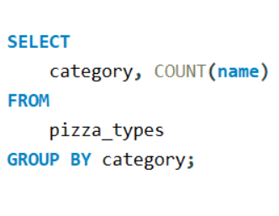
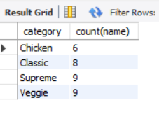
JOIN RELEVANT TABLES TO FIND THE CATEGORY-WISE DISTRIBUTION OF PIZZAS.

Slide 11
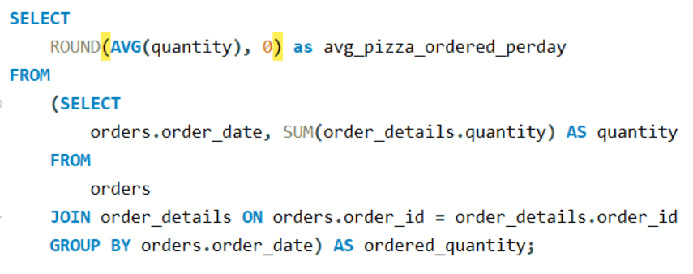

GROUP THE ORDERS BY DATE AND CALCULATE THE AVERAGE NUMBER OF PIZZAS ORDERED PER DAY.

Slide 12
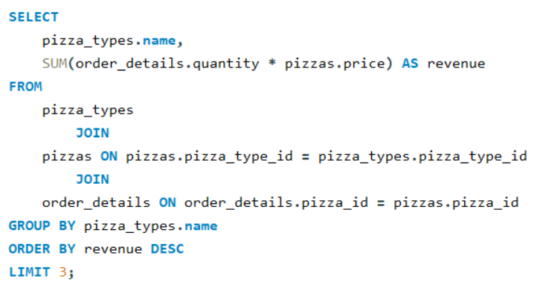
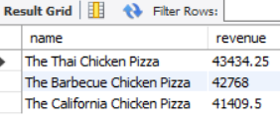
DETERMINE THE TOP 3 MOST ORDERED PIZZA TYPES BASED ON REVENUE.TITY OF EACH PIZZA CATEGORY ORDERED.

Slide 13
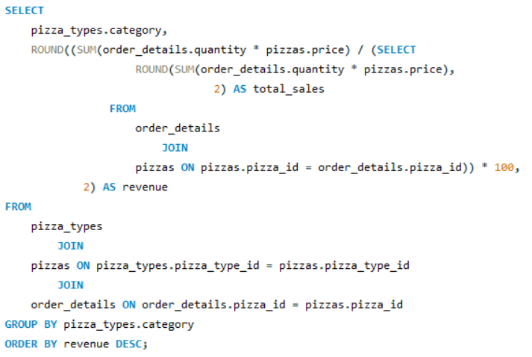
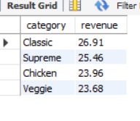
CALCULATE THE PERCENTAGE CONTRIBUTION OF EACH PIZZA TYPE TO TOTAL REVENUE.

Slide 14
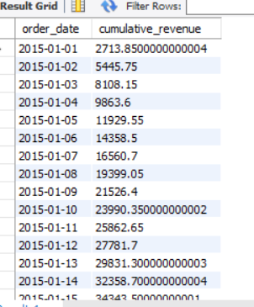
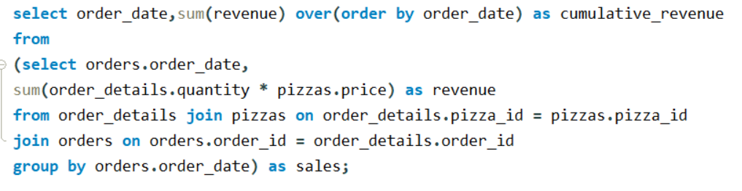
ANALYZE THE CUMULATIVE REVENUE GENERATED OVER TIME.

Slide 15
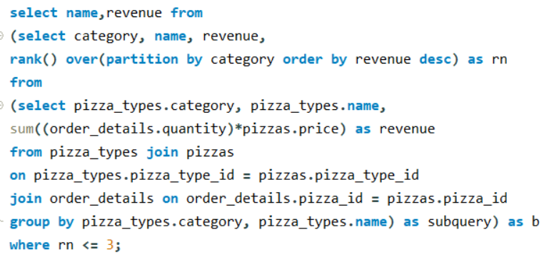
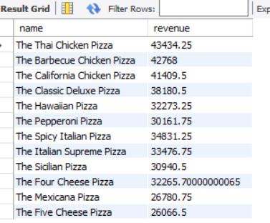
DETERMINE THE TOP 3 MOST ORDERED PIZZA TYPES BASED ON REVENUE FOR EACH PIZZA CATEGORY.

